Slide 1
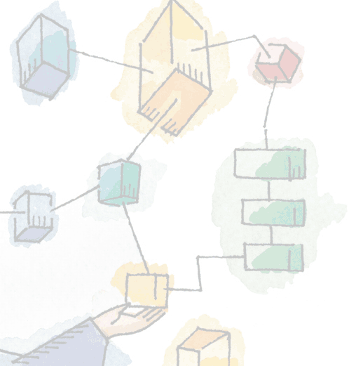
Chapter 7 Memory Management

Slide 2
Roadmap
Basic requirements of Memory Management
Memory Partitioning
Basic blocks of memory management
Paging
Segmentation

Slide 3
Uni-Programming
In a uni-programming system, main memory is divided into two parts:
One part for the operating system (resident monitor, kernel) and
One part for the program currently being executed.

Slide 4
Multi-Programming
In a multiprogramming system, the “user” part of memory must be further subdivided to accommodate multiple processes.
“Memory management is vital in a multiprogramming system.”
If only a few processes are in memory, then for much of the time all of the processes will be waiting for I/O and the processor will be idle.
Thus memory needs to be allocated to ensure a reasonable supply of ready processes to consume available processor time.

Slide 5
The need for memory management
Memory is cheap today, and getting cheaper
But applications are demanding more and more memory, there is never enough!
Memory Management, involves swapping blocks of data from secondary storage.
Memory I/O is slow compared to a CPU
The OS must cleverly time the swapping to maximise the CPU’s efficiency

Slide 6
Memory Management
“Memory needs to be allocated to ensure a reasonable supply of ready processes to consume available processor time”

Slide 7
Memory Management Requirements
Relocation
Protection
Sharing
Logical organisation
Physical organisation

Slide 8
Requirements: Relocation
Main memory is shared by multiple processes
The programmer does not know where the program will be placed in memory,
it may be swapped to disk and return to main memory at a different location (relocated)
Memory references must be translated to the actual physical memory address

Slide 9
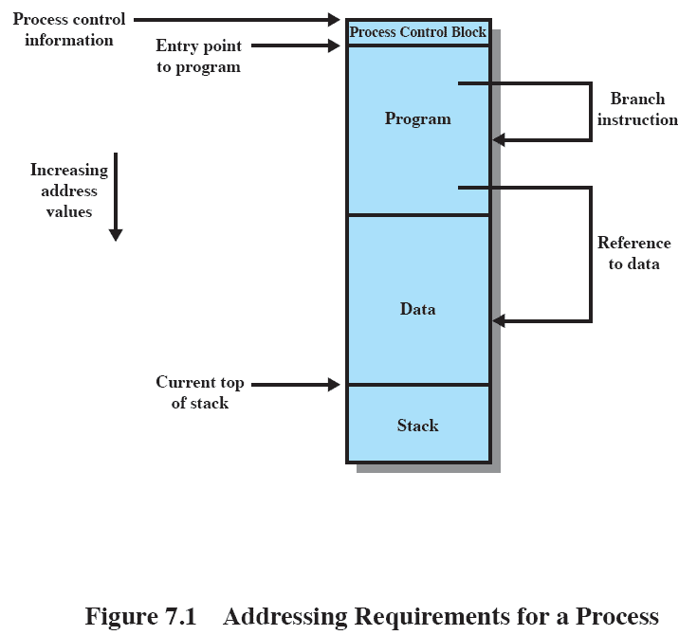
Challenge for Relocation: Addressing

Slide 10
Challenge for Relocation: Addressing
OS needs to know addresses of
PCB
Program Area
Stack Area
OS loads process in main memory at specific location so these addresses are known to it
Mapping between actual program references and physical memory locations needs to be done
This is done by processor hardware and OS together

Slide 11
Requirements: Protection
Normally, a user process cannot access any portion of the operating system, neither program nor data. –Why?
Usually a program in one process cannot branch to an instruction in another process or access the data area of another process. – Why?

Slide 12
Requirements: Protection
“Satisfaction of Relocation requirement increases the difficulty of satisfying protection”
Location of a process in main memory is not fixed
Run time checking of memory references Is needed

Slide 13
Requirements: Protection
Memory protection must be satisfied by processor rather than OS
OS cannot anticipate the memory references that a program will make
It will be a time consuming task if assigned to OS

Slide 14
Requirements: Sharing
Protection mechanism must have flexibility to allow several processes to access the same portion of memory
Better to allow each process access to the same copy of the program rather than have their own separate copy
Processes that are cooperating on some task may need to share access to the same data structure.

Slide 15
Requirements: Sharing
Hence memory management system must allow controlled access to shared area without compromising the protection requirement.

Slide 16
Requirements: Logical Organization
Memory is organized linearly (usually)
Programs are written in modules
Modules can be written and compiled independently
Different degrees of protection given to modules (read-only, execute-only)
Share modules among processes
Hence this mapping needs to be managed
Notes:
Main memory is usually organized as a linear, or one-dimensional, address space, consisting of a sequence of bytes or words.
Secondary memory, at its physical level, is similarly organized.
This does not correspond to the way in which programs are typically constructed. Most programs are organized into modules. If the operating system and computer hardware can effectively deal with user programs and data in the form of modules of some sort, then a number of advantages can be realized

Slide 17
Requirements: Physical Organization
Memory is organized in two levels: main memory and secondary memory
Main memory has the advantage of faster access but it is volatile
Secondary memory has the advantage of bulk and permanent storage but it is slow in access
The flow between main and secondary memory needs proper management

Slide 18
Requirements: Physical Organization
Cannot leave the programmer with the responsibility to manage memory
Memory available for a program plus its data may be insufficient
Overlaying allows various modules to be assigned the same region of memory but is time consuming to program
Programmer does not know how much space will be available
Notes:
Because of this, it is clear that the task of moving information between the two levels of memory should be a system responsibility. This task is the essence of memory management.

Slide 19
Partitioning
Basic operation of memory management unit is
Bring a process into main memory
This requires the memory to be properly partitioned
Hence partitioning is one of the important memory management techniques

Slide 20
Types of Partitioning
Fixed Partitioning
Dynamic Partitioning
Simple Paging
Simple Segmentation
Virtual Memory Paging
Virtual Memory Segmentation

Slide 21
Fixed Partitioning
If we assume that OS occupies some fixed portion of main memory
Rest of the space is available for processes
“Partition the available memory into regions with fixed boundaries”
Fixed Partitioning
Equal size
Unequal size

Slide 22
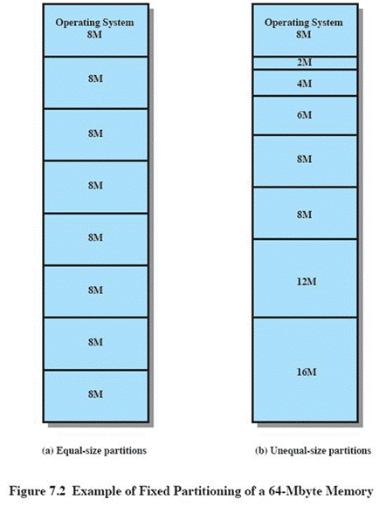
Fixed Partitioning
Equal-size partitions
Any process whose size is less than or equal to the partition size can be loaded into an available partition
The operating system can swap a process out of a partition
If none are in a ready or running state

Slide 23
Fixed Partitioning Problems
A program may not fit in a partition.
The programmer must design the program with overlays
Main memory use is inefficient.
Any program, no matter how small, occupies an entire partition.
This is results in internal fragmentation.
Solution??

Slide 24
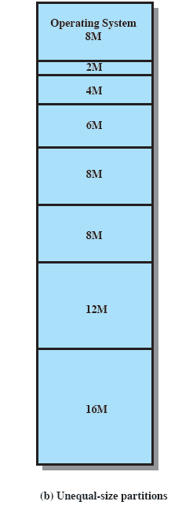
Solution – Unequal Size Partitions
Lessens both problems
but doesn’t solve completely
In Figure,
Programs up to 16M can be accommodated without overlay
Smaller programs can be placed in smaller partitions, reducing internal fragmentation

Slide 25
Placement Algorithm
Equal-size
Placement is trivial (no options)
As long as a partition is available, process can be loaded into it
Does not matter which partition to choose
If all partitions are occupied and no ready or running processes, swapping can be done

Slide 26
Placement Algorithm
Unequal-size
Can assign each process to the smallest partition within which it will fit
Processes are assigned in such a way as to minimize wasted memory within a partition
Queue models:
One queue per partition
Single queue

Slide 27
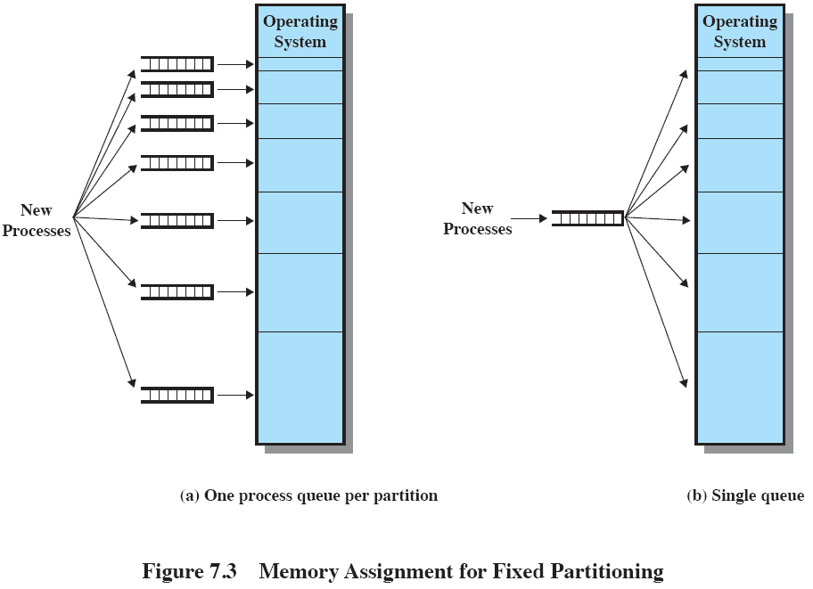

Slide 28
Placement Algorithm
Problem with one queue per partition is
It might be optimum from a partition point of view, but not optimum from system’s point of view
If there are no processes which can fit a particular partition, then it will remain unused
Hence, using a single queue is a better alternative

Slide 29
Advantages: Fixed Partitioning
Fixed partitioning schemes are relatively simple and require minimum operating system software and processing overhead
Unequal size partitioning provides flexibility to the basic approach

Slide 30
Remaining Problems with Fixed Partitions
The number of active processes is limited by the system
i.e. limited by the pre-determined number of partitions
A large number of very small processes will not use the space efficiently
In either fixed or variable length partition methods

Slide 31
Dynamic Partitioning
Partitions are of variable length and number
Process is allocated exactly as much memory as required

Slide 32
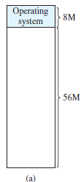
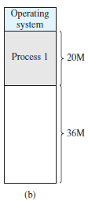
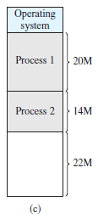
P1:20M
P2:14M

Slide 33
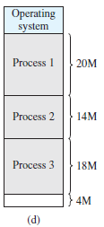
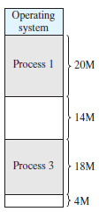
P3:18M
None Ready, new process arriving, Swap P2

Slide 34
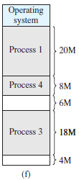
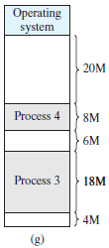
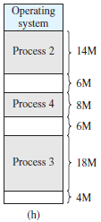
None Ready,
P2 Ready-Suspend,
Swap P1
P2 swapped in
P4:8M

Slide 35
Dynamic Partitioning: Issue
External Fragmentation
Memory external to all processes is fragmented
Can resolve using compaction
OS moves processes so that they are contiguous
Needs dynamic relocation
Time consuming and wastes CPU time

Slide 36
Placement Algorithms
Compaction is costly
Hence operating system must make intelligent decision when a process is brought in and multiple options are available
Three placement algorithms:
Best Fit
Next Fit
First Fit

Slide 37
Placement Algorithms
Best-fit algorithm
Chooses the block that is closest in size to the request
Worst performer overall
Since smallest block is found for process, the smallest amount of fragmentation is left
Memory compaction must be done more often

Slide 38
Placement Algorithms
First-fit algorithm
Scans memory form the beginning and chooses the first available block that is large enough
Fastest
May have many process loaded in the front end of memory that must be searched over when trying to find a free block
Small holes in front

Slide 39
Placement Algorithms
Next-fit algorithm
Scans memory from the location of the last placement
More often allocate a block of memory at the end of memory where the largest block is found
The largest block of memory is broken up into smaller blocks
Compaction is required to obtain a large block at the end of memory

Slide 40
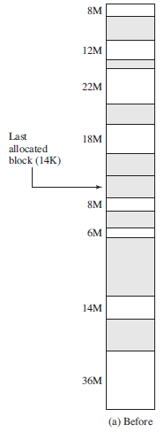

Notes:
Slide shows Fig 7.5 - an example memory configuration after a number of placement and swapping-out operations.
The last block that was used was a 22-Mbyte block from which a 14-Mbyte partition was created.
Figure 7.5b shows the difference between the best, first, and next-fit placement algorithms in satisfying a 16-Mbyte allocation request.
Best-fit will search the entire list of available blocks and make use of the 18-Mbyte block, leaving a 2-Mbyte fragment.
First-fit results in a 6-Mbyte fragment, and
Next-fit results in a 20-Mbyte fragment.

Slide 41
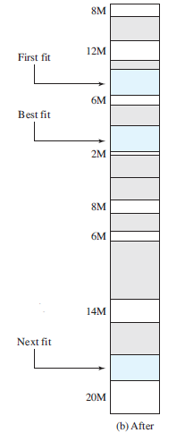

16M Allocation

Slide 42
Replacement Algorithms
In dynamic partitioning, when all processes in main memory are blocked and there is insufficient memory, even after compaction
OS must swap one of the process to bring a new process or a ready suspended process
This needs replacement algorithm

Slide 43
Common Drawbacks
Fixed Partitioning
Internal Fragmentation
Limits the number of active processes
Dynamic Partitioning
External Fragmentation
Compaction increases overhead
Another Approach
Buddy System

Slide 44
Buddy System
Entire space available is treated as a single block of 2^{U}
If a request of size s is made satisfying 2^{U-1}<s <= 2^{U}
entire block is allocated
Otherwise block is split into two equal buddies
Process continues until smallest block greater than or equal to s is generated
Notes:
In a fixed partitioning scheme limits the number of active processes and may use space inefficiently if there is a poor match between available partition sizes and process sizes.
A dynamic partitioning scheme is more complex to maintain and includes the overhead of compaction.
An interesting compromise is the buddy system.

Slide 45
Example of Buddy System
Consider block of 512 bytes
Request S=512 , 256<512 <= 512
Condition satisfied, Allocate entire block
Request S=400, 256<400 <= 512
Condition satisfied , Allocate entire block
Request S=200, Condition not satisfied
so split in two equal buddies (256,256)
Check condition again, 128<200 <=256
Allocate 256 byte block
Notes:
Figure 7.6 gives an example using a 1-Mbyte initial block.
The first request,A, is for 100 Kbytes, for which a 128K block is needed.
The initial block is divided into two 512K buddies.
The first of these is divided into two 256K buddies,
and the first of these is divided into two 128K buddies,
one of which is allocated to A.
The next request,B, requires a 256K block. Such a block is already available and is allocated.
The process continues with splitting and coalescing occurring as needed.
Note that when E is released,two 128K buddies are coalesced into a 256K block, which is immediately coalesced with its buddy

Slide 46
Available Space
Request A:100K
Request B:240K
Request C:64K
Request D:256K

Slide 47
Release B
Release A
Request E:75K
Release C
Release E
Release D

Slide 48
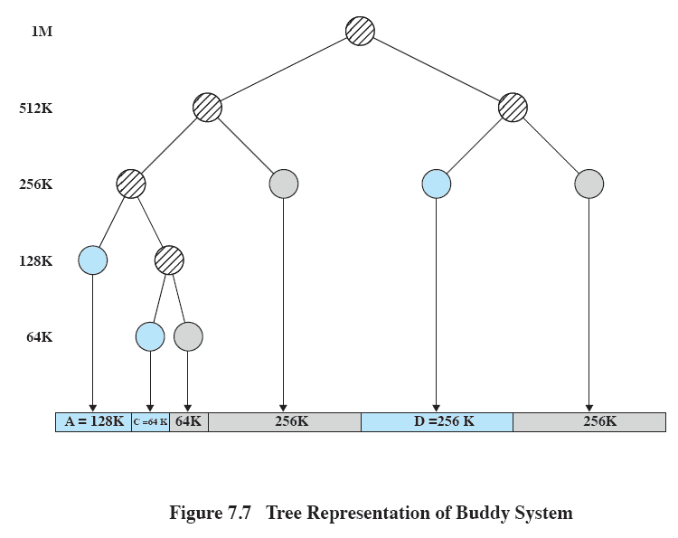
Tree Representation of Buddy System
Notes:
Figure 7.7 shows a binary tree representation of the buddy allocation immediately after the Release B request.
The leaf nodes represent the current partitioning the memory.
If two buddies are leaf nodes, then at least one must be allocated;
otherwise they would be coalesced into a larger block.
The buddy system is a reasonable compromise to overcome the disadvantages of both the fixed and variable partitioning schemes,
But in contemporary operating systems, virtual memory based on paging and segmentation is superior.
However, the buddy system has found application in parallel systems as an efficient means of allocation and release for parallel programs. A modified form of the buddy system is used for UNIX kernel memory allocation (described in Chapter 8).

Slide 49
Tree Representation of Buddy System
If two buddies are leaf nodes, then one of them must be an allocated node, otherwise they should be merged
At any point of time, the leaf nodes define current allocation

Slide 50
Relocation
When program loaded into memory the actual (absolute) memory locations are determined
A process may occupy different partitions which means different absolute memory locations during the lifetime
Reasons?
Swapping
Compaction

Slide 51
Relocation
The schemes where relocation is needed:
Equal size fixed partitioning
Unequal size fixed partitioning (single queue)
Dynamic partitioning
Compaction
Hence physical memory references of a process are not fixed
This issue is the focus of addressing

Slide 52
Types of Addresses
Physical or Absolute
The absolute address or actual location in main memory.
Logical
Reference to a memory location independent of the current assignment, generated by CPU
Relative
Logical address, where address expressed as a location relative to some known point (i.e. beginning).
Notes:
A translation must be made from both Logical and Relative addresses to arrive at the Absolute address

Slide 53
Address Translation
For system with relative addressing, address translation is done in two steps:
Load
Load process in main memory with all references in relative form
Calculate
Calculate physical address when instructions or data with relative address is encountered

Slide 54
Registers Used during Execution
Base register
Starting address for the process
Bounds register
Ending location of the process
These values are set when the process is loaded or when the process is swapped in

Slide 55
Address Translation
When a process is assigned running state, base register is loaded with starting physical address of the process
Bound register is loaded with ending physical address
When relative address is encountered
The value of the base register is added to a relative address to produce an absolute address

Slide 56
Address Translation
The resulting address is compared with the value in the bounds register
If the address is not within bounds, an interrupt is generated to the operating system
This mechanism supports protection

Slide 57
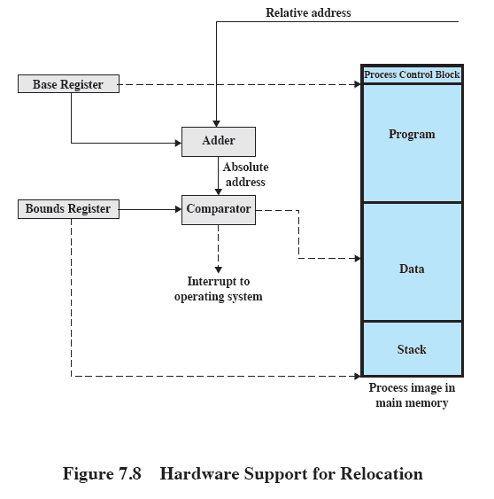
Hardware Support

Slide 58
Paging
In paging scheme,
Main memory is partitioned into small, fixed-size chunks
Each process is divided into the same size chunks
The chunks of memory are called frames
The chunks of a process are called pages

Slide 59
Paging
When a process is to be loaded in main memory,
Free frames are found
Pages are loaded into those frames
List of free frames is maintained by OS
If contiguous frames are not available,
Then also new process can be loaded
This requires a data structure to keep track of current allocation

Slide 60
Paging- Page Table
Operating system maintains a page table for this purpose
1 page table per process
Page Table Entry contains the frame location where the page is stored

Slide 61
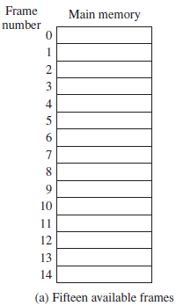
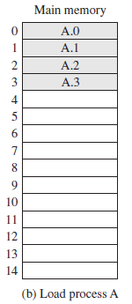
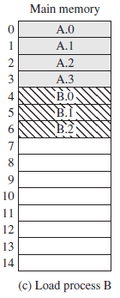
Paging Example
A:4 Pages
B:3 Pages

Slide 62
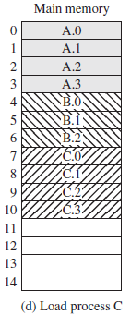
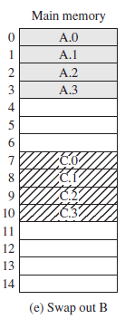
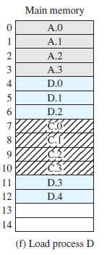
Paging Example
C:4 Pages
All blocked,
bring new D:5 pages
D:5 Pages

Slide 63
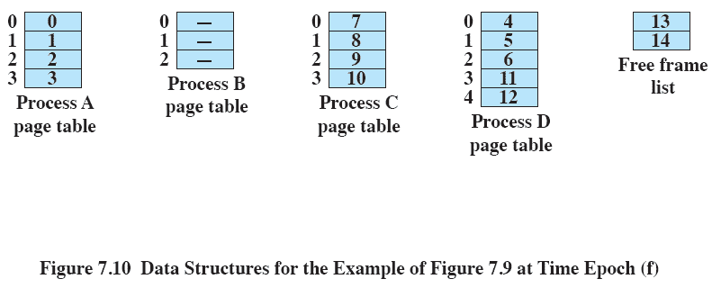
Page Table Entries

Slide 64
Paging: Address Structure
Each logical address in program is a pair
Page Number
Offset
E.g. Page 1 offset 5
Address Translation
Page number, offset
To
Frame number, offset
Done by processor hardware

Slide 65
Paging vs. Fixed Partitioning
Paging has small partition size compared to fixed partitioning
Paging does not require partitions to be contiguous
Paging results into small amount of internal fragmentation (last page)

Slide 66
Paging: Example
Consider the memory supporting 16 bit addresses,
address space is 64K
Given page size 1024 bytes (1 K)
Number of pages?
2^16/ 2^10 = 2^6
64 pages of 1K each
Address Structure?
10 bits offset, 6 bits page number = 16 bit address

Slide 67
Paging: Example
Logical Address =31 bits
Address space = 2^1 * 2^30 (2 G)
Address space=128M (2^7 * 2^20)
Logical Address= 27 bits
Physical Address= 22 bits
Address space= 2^2 * 2^20 (4 M)
Address space=16M (2^4 * 2^20)
Physical Address= 24 bits

Slide 68
Paging: Addresses
Given physical address = 12 bits
Logical address = 13 bits
Page size = Frame size = 1 K
Number of Pages?
Number of Frames?
Structure of Logical Address?
Structure of Physical Address?
Notes:
2^3 = 8 pages
2^2 = 4 frames
3+10
2+10

Slide 69
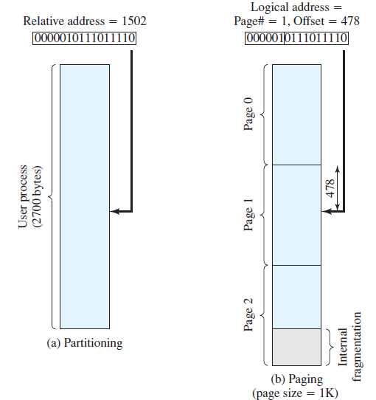
Paging: Addresses
If page size and frame size are power of 2, then relative address and logical address are the same

Slide 70
Paging: Address Translation
Consider an address of n+m bits, where leftmost n bits are the page number and the rightmost m bits are the offset
Address translation Steps:
Extract the page number as the leftmost n bits
Use the page number as an index into process page table to find frame number, k
Generate physical address by appending frame number with offset

Slide 71
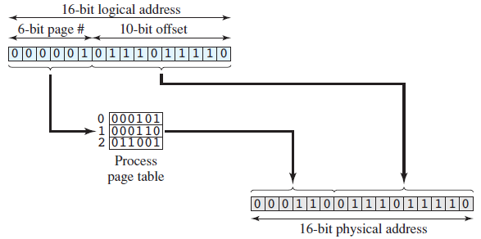
Paging: Address Translation

Slide 72
Paging: Summary
Simple paging
Divide main memory into many small equal size frames
Divide process into frame-size pages
Smaller processes require fewer pages
Larger processes require more pages
When a process is brought in, all of its pages are loaded into available frames and page table is setup

Slide 73
Segmentation
A user program can be subdivided into segments
Segments may vary in length
There is a maximum segment length
Similar to dynamic partitioning due to unequal size segments
Addressing consist of two parts
a segment number and
an offset
Notes:
The difference with dynamic partitioning, is that with segmentation a program may occupy more than one partition, and these partitions need not be contiguous.
Segmentation eliminates internal fragmentation but suffers from external fragmentation (as does dynamic partitioning)
However, because a process is broken up into a number of smaller pieces, the external fragmentation should be less.
A consequence of unequal-size segments is that there is no simple relationship between logical addresses and physical addresses.
Analogous to paging, a simple segmentation scheme would make use of a segment table for each process and a list of free blocks of main memory. Each segment table entry would have to give
the starting address in main memory of the corresponding segment.
the length of the segment, to assure that invalid addresses are not used.
When a process enters the Running state, the address of its segment table is loaded into a special register used by the memory management hardware.

Slide 74
Segmentation
One segment table per process
Segment table entry
Starting address of segment in main memory
Length of segment
When a process enters running state,
Address of segment table is loaded into main memory

Slide 75
Segmentation: Address Translation
Address translation Steps:
Extract the segment number as the leftmost n bits
Use the segment number as an index into process segment table to find starting physical address of segment
Compare offset with the length, if offset greater than length, address is invalid
Generate physical address by appending starting address with offset

Slide 76
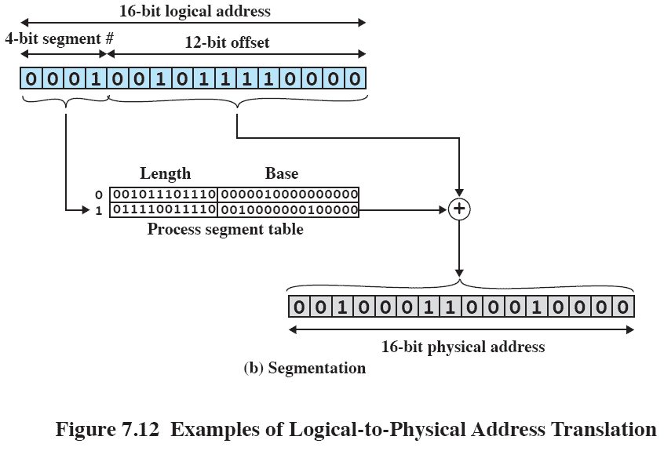
Segmentation
Notes:
In our example, we have the logical address 0001001011110000, which is segment number 1, offset 752.
Suppose that this segment is residing in main memory starting at physical address 0010000000100000.
Then the physical address is 0010000000100000 + 001011110000 =0010001100010000

Slide 77
